Slide 1

Candidate Voice Search
When Your Voice Becomes the Ultimate Digital Control
Tap Here to Start With Us

Slide 2
The Perfect Timing for
a Shift
Speaking predates writing.
make recruitment easier by combining voice recognition, smart candidate matching, and automated delivery through different channels
Voice-based candidate search using AI
Traditional search is slow because it requires manual filtering and reviewing many profiles.
This system allows users to speak their requirements, and the AI automatically finds, ranks, and explains the best candidates, saving time and improving accuracy.
Modern life is fast-paced, with people multitasking frequently. Voice interaction enables hands-free control, enhancing speed and convenience, making it ideal for efficient candidate search.
Tap Here to Start With Us

Slide 3
Breaking down the process behind seamless voice interaction
Voice Capture
Language Understanding
Decision & Action
Response
Voice input
using Whisper for transcription
uses Qdrant vector database for semantic search
results delivered via Email or Slack
React frontend
parsed to extract parameters such as industry, salary
ranks candidates by experience
using N8N workflows
FastAPI backend
generates AI explanations using Gemini

Slide 4
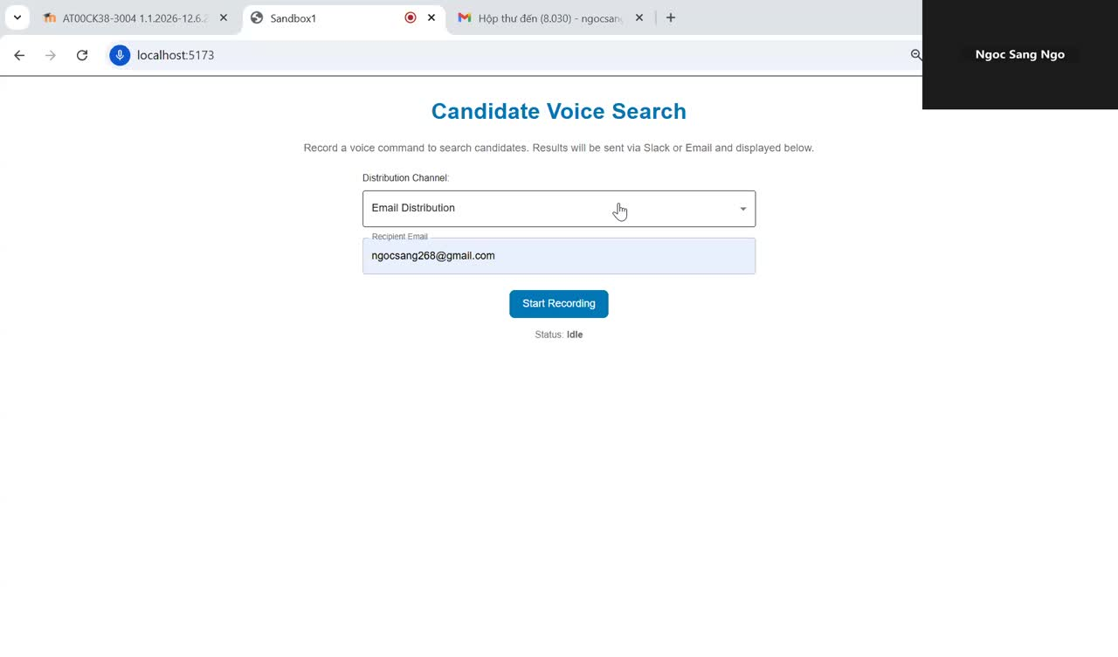
How the platform lets recruiters search for candidates through voice commands
Recruitment is simplified by combining speech recognition, AI matching, and automated multi-channel output

Slide 5

Voice recording and transcription using Whisper
Voice recording and transcription
Candidate search results displayed in interactive cards
Voice AI provides 24/7 support, reducing wait times and improving communication.
AI-generated match explanations
Multi-channel output: Slack / Email
Transforming recruitment
Rich candidate details: skills, licenses, languages, education, experience, salary, availability
Interactive Gmail invitation composition

Slide 6

The project demonstrates how AI can simplify and automate recruitment workflows.
Voice commands are faster than traditional typing for tasks like messaging, and online searches. This efficiency enhances productivity and creates a more natural digital interaction.
Speed Matters
in the Digital Era

Slide 7
Addressing authentication, real-time streaming transcription, and deployment to cloud infrastructure.
What Still Needs Improvement

Slide 8
Thank you for your attention.
Let’s create a future where technology listens, understands, and enhances human potential.

